Slide 1
Heathy Soil for Healthy Vineyards

Slide 2
Agenda
Healthy Soils for Healthy Vineyards: Technical & Financial Assistance | Anna Mariscal Amador Resource Conservation District
Cover Crops | Margaret Smither-Kopperl USDA Natural Resource Conservation District Nigel Dreksler Kamprath Seed
Livestock Integration | Dan Macon UC Agricultre & Natural Resources Division
Integrated Pest Management | Hanna Kahl Community Alliance of Family Farmers
Ironstone Vineyards – Sustainability Tour | Stephan Kautz Ironstone Vineyards

Slide 3
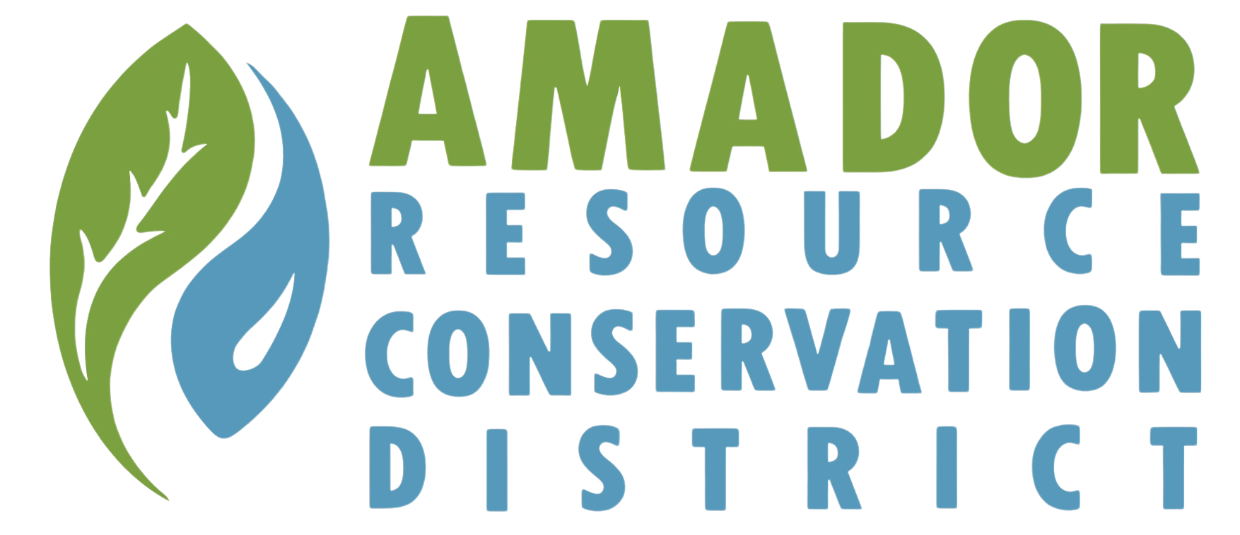
Healthy Soils for Healthy Vineyards Technical & Financial Assistance
Anna Mariscal Healthy Soils Natural Resources Specialist

Slide 4
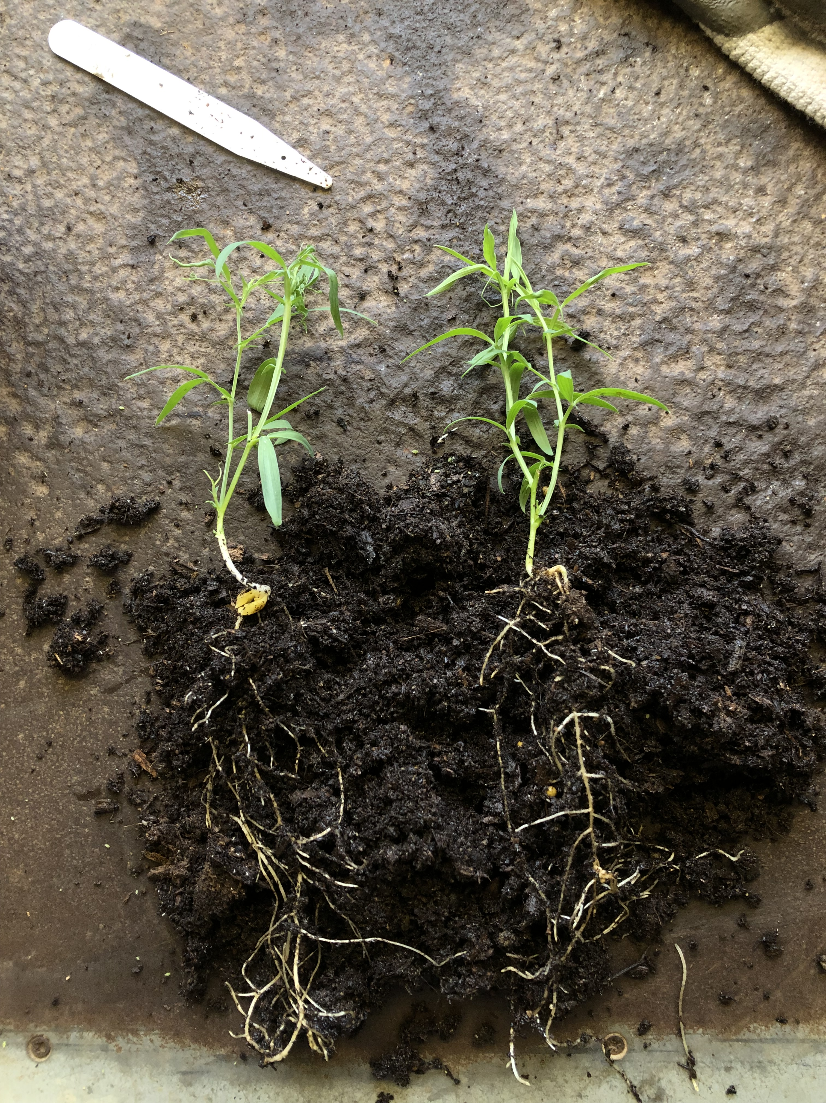
Soil Is a Living medium
A living ecosystem.
Functions provide ecosystem services.
Functions are driven by dynamic interactions, species to species, organic to inorganic (vice versa).
Delicately connected and in constant flux.
Human activity is directly correlated to soil health and ecosystem function.
Soil management is a part of (nearly) all agricultural types, whether intentional or not.
Deserves our attention, care, and protection.

Slide 5
Healthy Soil Function
USDA NRCS: “Soil health is defined as the continued capacity of soil to function as a vital living ecosystem that sustains plants, animals, and humans.”
“The capacity of a soil to function within ecosystem boundaries to sustain biological productivity, maintain environmental quality, and promote plant, animal and human health.”
Cultivates a richer environment below ground (and above ground)
Regulate itself in the face of environmental and climatic pressures
Sufficiently captures and manages energy, water, and nutrients
Influences:
Water Cycle
Carbon Cycle
Nutrient Cycling
Water & Air Quality
Biodiversity
Yield Stability & Resiliency
Our Wellbeing

Slide 6
Principles of Soil Health
Maximize presence of living roots
Minimize Disturbance
Maximize Soil Cover
Maximize Biodiversity
Animal Integration
CONTEXT

Slide 7
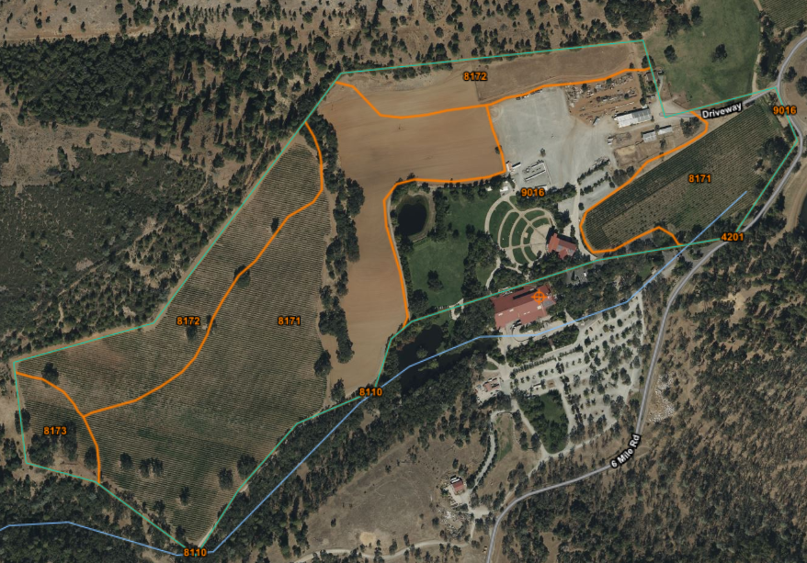
Web Soil Survey

Slide 8
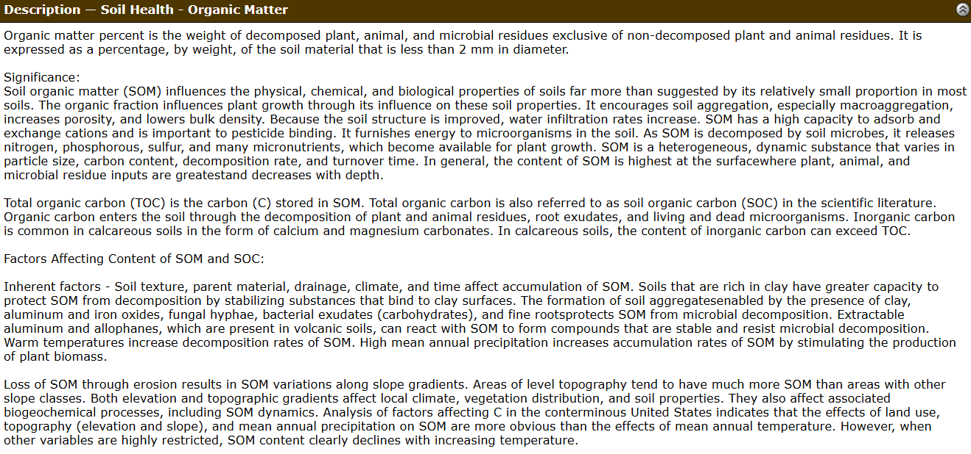

Slide 9
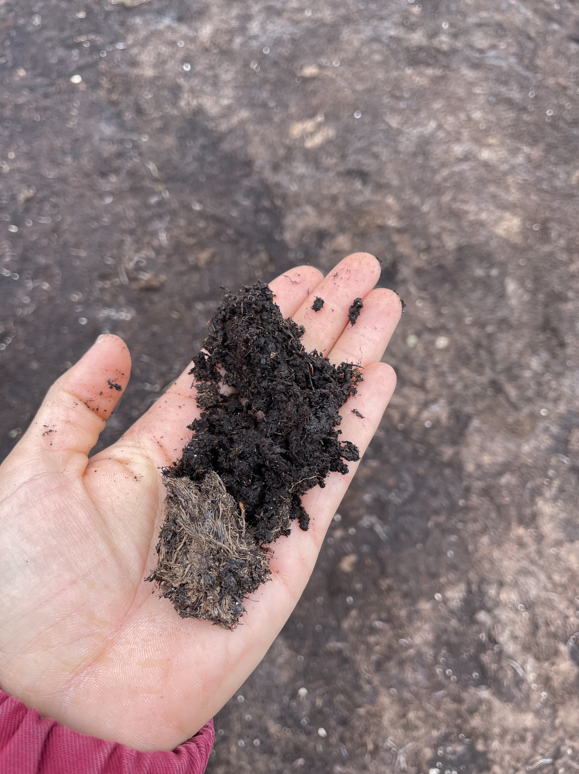
Indicators of Soil Health
Organic Matter
Water Infiltration
Available Water Capacity
Aggregate Stability
Bulk Density
Etc.
(looking beyond fertility)

Slide 10
Impact
https://holisticmanagement.org/the-regenerative-solution/addressing-climate-change/
https://www.nrcs.usda.gov/sites/default/files/2022-12/soil-health-key-points.pdf

Slide 11
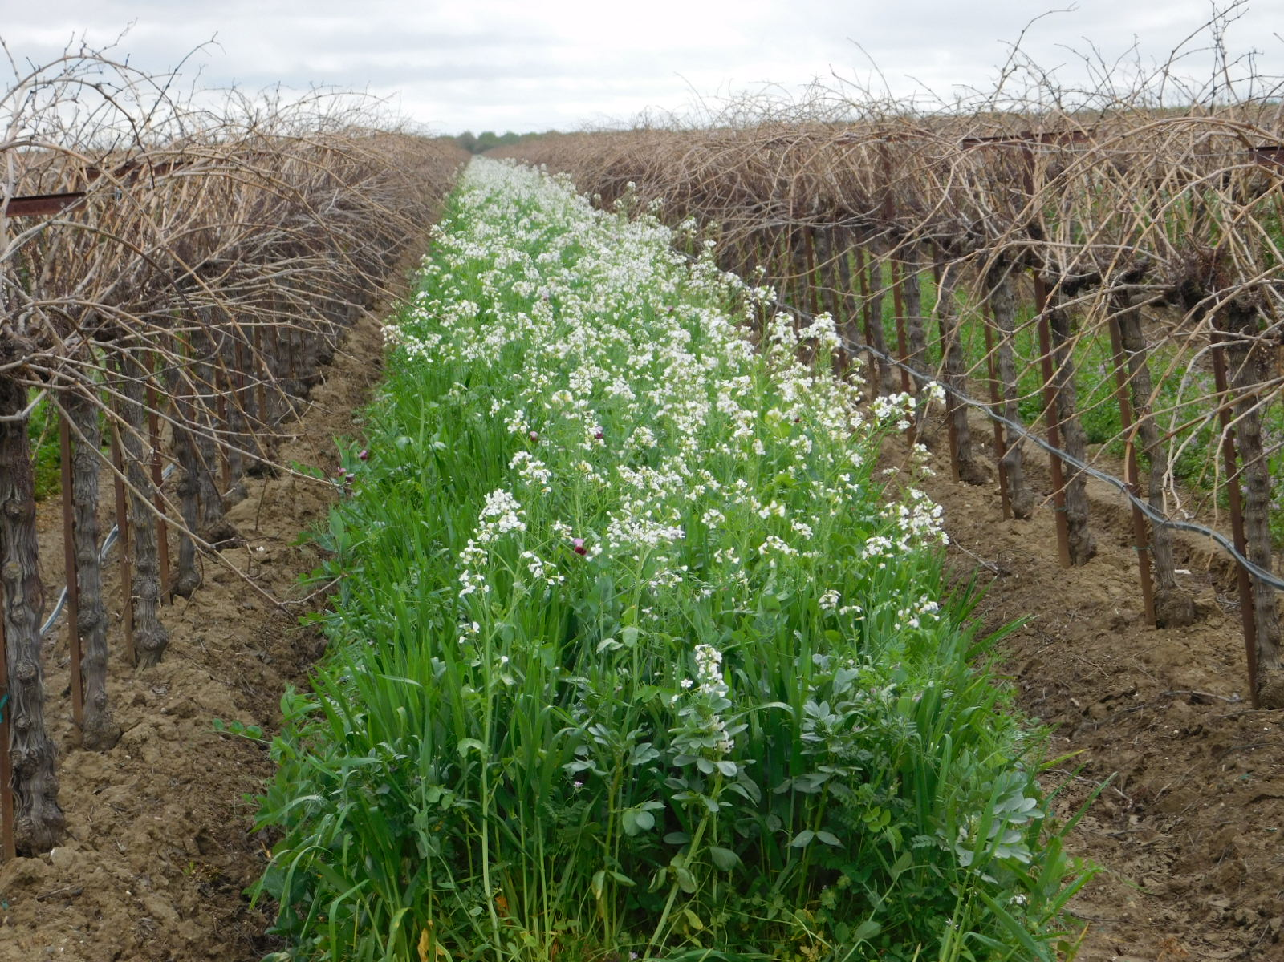
CDFA Healthy Soils Program Incentives Grant
Direct-to-Farmer Grants to incentivize the implementation of soil conservation practices
Free Technical Assistance
Statewide
Funding is cyclical
Maximum award $100,000
Monitoring Component

Slide 12
Central Sierra Healthy Soils Program
Regional implementation of CDFA Healthy Soils Program
Administered by regional producer organizations and/or RCDs
Maximum award $200,000 per project
Not competing within statewide grant program
Funding is already designated to regions and grant program management occurs locally
Pilot Program

Slide 13
Eligible HSP Vineyard Practices
Compost Application
Compost Purchased from a Certified Facility
On-farm Produced Compost
Conservation Cover
Cover Crop
Filter Strip
Hedgerow Planting
Windbreak/Shelterbelt Establishment
Mulching
Nature Materials
Wood Chips
Nutrient Management (15% reduction in fertilizer application only)
Residue and Tillage Management – No-Till
Residue and Tillage Management − Reduced Till
Whole Orchard Recycling

Slide 14
USDA Natural Resource Conservation Service
Technical Assistance
Implementation Plans
Conservation Planning
Implementation Funding
EQIP
Environmental Quality Incentives Program
NRCS’ flagship conservation program
Helps farmers, ranchers and forest landowners integrate conservation into working lands.
CSP
Conservation Stewardship Program
Rewards agricultural producers and forest landowners for being good stewards of the land by incentivizing them to maintain and/or improve the quality of natural resources.
Enhances existing efforts
NAQI
National Air Quality Initiative
Helps agricultural producers meet air quality compliance requirements
Provides technical and financial assistance for improving agricultural operations.
Replacement of older diesel-powered tractor.

Slide 15
Additional Financial Assistance
Pollinator Partnership CAFF Wild Farm Alliance
Point Blue Conservation Science
Zero Foodprint
Roots Program – Wildlife Habitat and Community Resilience on Working Lands
Technical Assistance offered by Point Blue Partner Biologist/Ecologist
$100,000 maximum awards
Example projects:
Hedgerow planting
Oak woodland restoration
Riparian restoration
Invasive species removal
Wildlife piles / structures
Restore Grants – Direct-to-farmer grants to sequester atmospheric carbon in the form of soil through soil conservation practices.
Example practices: no till, reduced till, conservation cover, forage & biomass planting, silvopasture, compost, mulching, nutrient management, alley cropping
Compost Connector Grant - Compost cost “offset”discount for compost purchased!
Technical Assistance Available
Enhanced Farmland For Pollinators, Crops, And Soil Grant
Create climate resilient habitat for pollinators
Implementation funding for:
Hedgerows
Conservation cover
Cover crop
Field border
Tree and shrub establishment
Wildlife habitat planting
Integrated pest management

Slide 16
Thank you
Anna Mariscal
(209) 217-1051
anna@amadorrcd.org

